Slide 1
BCS122 Data Structure & Algorithms
Lecture 3: Linked List
Muhammad khan
Department of IT

Slide 2
Objectives
Basic Concept of Linked list
Memory allocation and issues
Implementation of linked list
Operations on linked list
Applications of linked list

Slide 3
Contents
Memory allocation
Inefficient use of Memory
Static Memory allocation
Dynamic Memory allocation
List data structure
  Array based list
  Pointer based list
Linked list - Operations
  Creating, Insertion, and Deletion
Variation in Linked List
  Doubly linked list
  Header node
Applications of Linked-List

Slide 4
Memory Allocation
The main objective of this lecture to discuss and learn the efficient use of memory.
Generally, memory is allocated by Operating system to all variables defined in a computer program.
  For example,
int x, y;
float a[10];
float *total;

Slide 5
Inefficient Allocation
The issue arises because of inefficiencies inherent in the way memory is allocated for arrays. When you declare an array of size 1000, all 1000 memory locations are reserved for the exclusive use of that array.
No matter how many values you actually store in the array, you will always use 1000 memory locations.
The same memory allocation strategy is used for most implementations of strings.

Slide 6
Efficient Allocation
Alternative strategy, dynamic allocation, involves allocating memory on an as-needed basis.
maximum memory (depend on the maximum need of the program) can be reserved may be equal to the amount of memory that is physically available on your computer (more precisely, the amount of memory that is addressable by your computer).

Slide 7
Static Vs Dynamic Allocation
It can be noted from discussion that memory can be allocated in two ways:
  Static
  Dynamic

Slide 8
Static Memory Allocation
In static memory allocation, the memory location hold by program from the compilation till the termination of the program.
Examples:
int a,b;
int x[10];

Slide 9
Problems of Static Allocation
Static allocation is fixed through the program execution from first instruction till last.
all the memory that a data structure might possibly need (as specified by the user) is allocated all at once without regard for the actual amount needed at execution time.
Although arrays are good things, we cannot adjust the size of them in the middle of the program.
If our array is too small - our program will fail for large data.
If our array is too big - we waste a lot of space, again restricting what we can do.
To avoid above problems, dynamic memory allocation will be the right answer,

Slide 10
Dynamic Memory Allocation (Pointer Based)
The right solution is to build the data structure from small pieces, and add a new piece whenever we need to make it larger.
Pointers are the connections which hold these pieces together!

Slide 11
Pointer in Real Life
In many ways, telephone numbers serve as pointers in today's society.
  To contact someone, you do not have to carry them with you at all times. All you need is their number.
  Many different people can all have your number simultaneously. All you need do is copy the pointer.
  More complicated structures can be built by combining pointers. For example, phone trees or directory information.

Slide 12
Situations of Dynamic Memory Allocation
There are three situations in which memory can be allocated dynamically.
  calling a function that requires temporary storage to hold the value of the parameters, local variable and return value.
  the second situation is when blocking, the control is passed to an inner block and execution for the outer block is suspended.

Slide 13
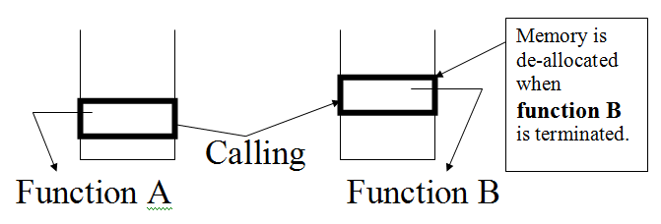
Situations of Dynamic Memory Allocation
Memory manager uses stack concept to implement the above situations;

Slide 14
Situations of Dynamic Memory Allocation
  Third situation when programmer asked for it.
    Dynamic allocation is done through pointer data structure.
    Pointers can be obtained and delete during the execution of a program. Hence, it is dynamical in nature.
    Therefore, it is not necessary to hold data until the end of program.
    Pointer variable or simply a pointer, contains the location, or address in memory, or a memory cell.

Slide 15
Declare a pointer
How do you get a pointer variable P to point a memory cell?
How do you use P to get to the contents of the memory cell to which P points?
Example:
int* P;
or typedef int* ptrtype;
prytype P;

Slide 16
New operators
C++ provides a New operator which create a new pointer.
Example: P=new int;

Slide 17
Delete Operator
In situation when pointer is not required, C++ uses delete operator to delete its contents and free the memory location.
Example: Delete p;

Slide 18
Null
Null can be assigned to pointer variable. It replaces the current value of pointer with key word ‘null’. Indicates that the pointer is empty.
Example: P=null;

Slide 19
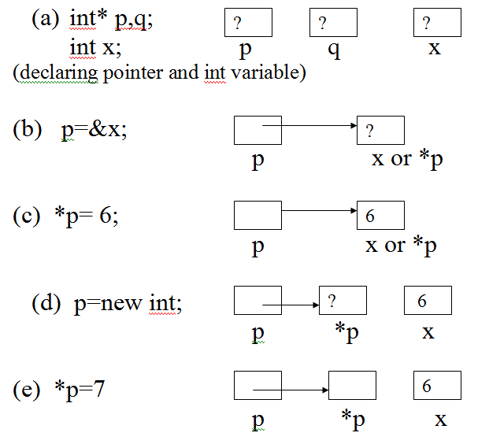
Example on the working of pointers (1)
the process of declaring, assigning, deleting pointers is shown below diagrammatically:

Slide 20
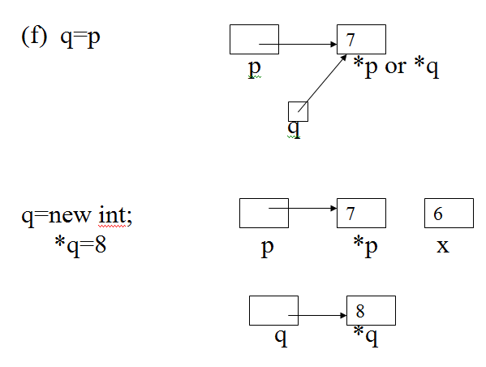
Example on the working of pointers (2)

Slide 21
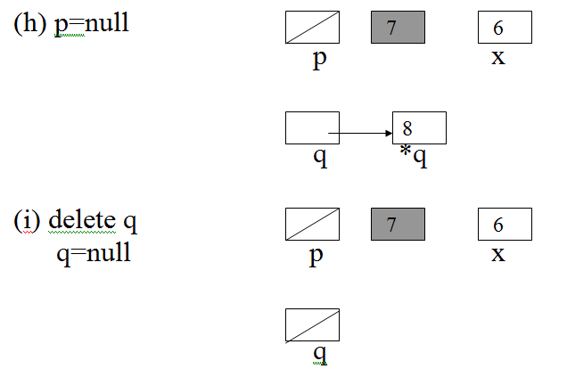
Example on the working of pointers (3)

Slide 22
Dynamic Allocations of Arrays (1)
Array can be created dynamically.
Non-pointer based array maintains a fixed size which cannot be changed during the execution.
Example:
int arraysize =50;
double* B new double[arrayasize];
*B is equivalent to B[0]
*(B+1) is equivalent to B[1] and so on.

Slide 23
Dynamic Allocations of Arrays (2)
During the program execution an array size can be changed.
Example:
Double* oldarray =B;
Double* B new double[2*arraysize];
for (int i=0; i<arraysize; ++i)
B[i]=oldarray[i];
Delete [ ] oldarray; // delete array

Slide 24
Pointer to structure
Pointer can be used to assign to structure for an efficient use of the memory.
For example:
struct node
{ int item
node* next-item;
}
typedef node* ptrtype;
ptrtype p;

Slide 25
Pointer to structure
Last statements define a structure named node with two items, i.e., item an integer and next as pointer node type,
Important to note that the pointer is pointing to node (whole node), i.e., why its type is node type, not an integer etc.

Slide 26
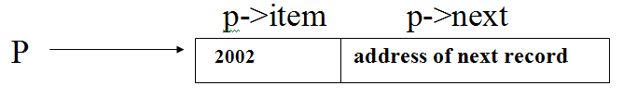
Pointer to structure
p= new node;
it will create ‘p’ with the following two locations:
Note: This concept will be discussed in details in the next couple of lectures.

Slide 27
Problems with Dynamic Memory allocation (1)
Freeing Memory after finish:
  The user is responsible for freeing up memory when he is finished with it. It is an important operation, a potential source of bugs that are very hard to find.
    Freeing location before you're actually finished with it.
    further access to the location will either cause a run-time error (memory violation)

Slide 28
Problems with Dynamic Memory allocation (2)
with the dynamic allocation the `free' parts of memory are not all together in one contiguous block.
For example: (shaded are used locations)
This is called fragmentation of memory, and it can grow into a very serious problem:
  it is possible to have a large amount of free memory but for it to be broken up into such tiny fragments that there is not enough contiguous free space to store another name.

Slide 29

List Processing and List Data Structures
List is a data structure in which items are stored after each other in a sequence.
For example:
List can be implemented using the following two methods:
  Array based list
  Pointers based list

Slide 30

Array Based Lists
A array can be used to store items in any order and of any type.
e.g.;
Const int size =10;
int list [size]
int count = 0;
The above structure will reserve 10 locations in computer memory:

Slide 31
Advantages
Easy to use
Useful for static data, i.e, no. of months in one year (do not change often)
Needs less memory (do not need for extra pointers etc.)

Slide 32
Disadvantages
Fixed (cannot be increased during execution of the program)
Difficult to add/insert new item at location other than last location
Difficult to delete item in the beginning or middle
Searching is time consuming

Slide 33
Examples (for disadvantages)
Insertion at 0 location requires to push all element one down in the list.
Deleting the first element requires shifting all the elements in the list by one.
Because of the running time for insertion and deletions is so slow and the list size must be known in advance, simple arrays are generally not used to implement list.

Slide 34
Programming Example
Create an array and enter require data in it
Write a function to add new item
Write a function to delete an item
Write a function to search an item

Slide 35
Pointer based List
All the dynamic data structures we will build have certain shared properties.
  We need a pointer to the entire object so we can find it. Note that this is a pointer, not a cell.
  Each cell contains one or more data fields, which is what we want to store.
  Each cell contains a pointer field to at least one ``next'' cell. Thus much of the space used in linked data structures is not data!

Slide 36
Pointer based List
  We must be able to detect the end of the data structure. This is why we need the NIL pointer.
  Pointers are used and considered to be more useful to implement the linked list.
  A linked list consists of nodes which represents elements.
  Each node in the list contains two information, i.e, element and pointer to next element.

Slide 37
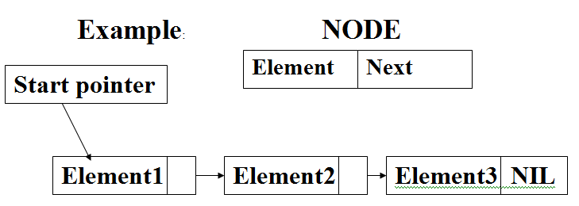
Example of linked list

Slide 38
Common Operations on Linked Lists
Create node
displaying a node
insert a node in the list
deletion node from the list
traverse the list
check whether the list is empty or not.

Slide 39
Example to create a node (for a linked list) in C++
Struct node
{
int data;
node* next;
};
typedef node* ptrtype;
ptrtype p;
(after this, linked list can be accessed using pointer ‘p’);
e.g. p= new node;

Slide 40
Accessing Members of the List
data item:
p→data;
will give data stored in the list
Pointer item:
p→ next;
will give the address of the next node in the list,

Slide 41
Issues of Linked List
Two issues are associated with linked list data structure:
  To determine last element
  To determine first element;

Slide 42
Solution to Issues with Linked List
To determine last element – Null can be assigned to the last nodes’ pointer
To determine first element – an extra node such a head may be created to point to the first node;
For example:
  ptrtype head; (with this statement an extra node named head will be created)

Slide 43
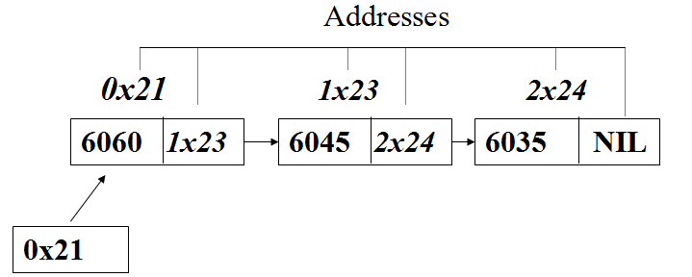
Example

Slide 44
Example
In the above list there are three items, namely: 6060, 6045, and 6035.
The list also contains 3 pointer storing addresses of the node ahead of it,
i.e., the address of the 2nd node is stored in first node, - 1x23 and so on.

Slide 45
Creating a Linked List Using C++
// structure for linked with two elements creates here
struct node
{
int info;
node* next;
};
typedef node* ptr;
// define ‘ptr’ as a pointer type of the structure ‘node’

Slide 46
Function to create linked list and put three items
void function-createlnkedlist()
{
ptr Q, Head, P, current;
// create a number of pointer to maintain the linked list
Q= new node;
Head=P=current=Q;
// data entry part of linked list program
for (int i=1; i<4;++i)
{
cout<<"Enter a number: ";
cin>>Q->info;
P->next = Q;
P=Q;
Q= new node;
} // end of for loop ‘i’
P->next = NULL;
P=new node;
delete P,Q;
} // end of the function

Slide 47
Displaying the linked list
void function-display-linkedlist()
{
cout << "\n" << "Items in the linked List" << "\n";
for (i=1; i<4; ++i) // displaying contents of linked list
{
cout << current->info << " ---> ";
current=current->next;
} // end of for loop no. 2
delete current;
} // end of function

Slide 48
Inserting Node in the linked list
Three possible location to insert a new node (i.e., data item) in the linked list: which are as follows:
  Insertion at the start of the list
  Insert in middle of list
  Insert at the end of list

Slide 49
General Procedure
Determine the point of insertion
Create a new node and store the new data in it.
Connect the new node to the linked list by changing pointers.

Slide 50
Inserting a node at the beginning of Linked List
Since list a dynamic data structure so we are not worried about the number of locations in the list.
It is relatively easy to insert a new node at the beginning of the linked list as compared in the middle.

Slide 51
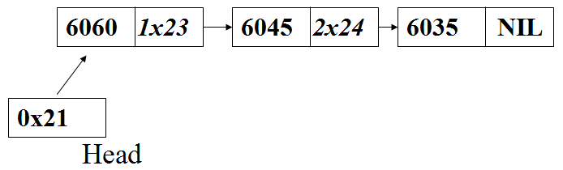
Inserting a node at the beginning of Linked List
The following algorithm will be followed:
(assumed that we have a linked list of the following type)

Slide 52
Algorithm
  create a new node as:
such as: q = new node; (where q is a valid node type pointer)
  obtained new data item from user, e.g, ‘x’ is a new data item.
  add this new data item (x) into the new node.
  add the address of the first node in the list in the new node, such as
    q→next=head
  stored the address of the new node in head node, such as head = q;

Slide 53
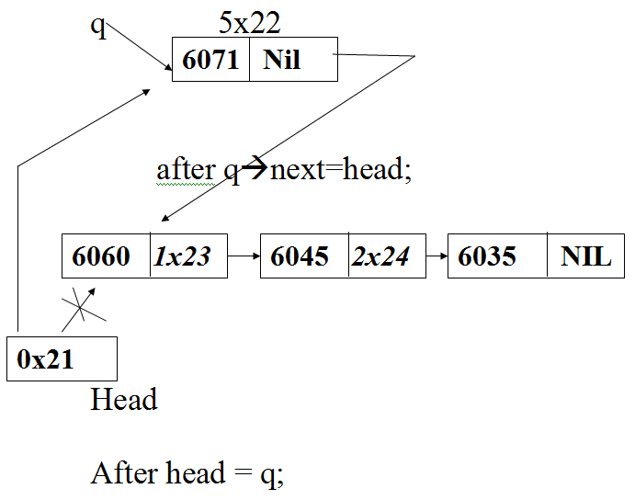
Example using List and Algorithm
Suppose we get a new node and data item (6071) for it, such as

Slide 54
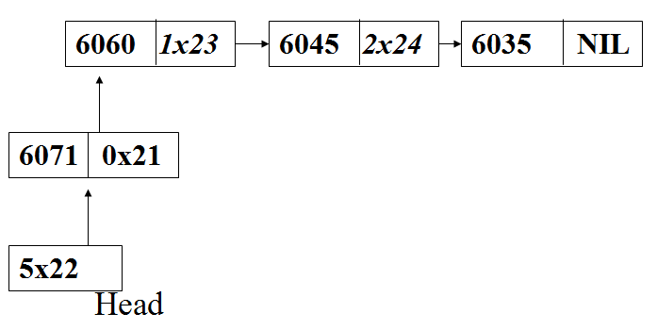
List after insertion at the beginning of list
Now the list contains four nodes, as a new node was added to beginning of the linked list, with data item 6071 and address 5x22.

Slide 55
Insertion somewhere in the middle of the list
Algorithm/Procedure
  Get new data to be inserted
  Get the location where the data to be inserted
  Search for the location in the list
  Create a new node
  Amend pointers of the nodes before and after the location where the new data to inserted
  See example on next slide

Slide 56
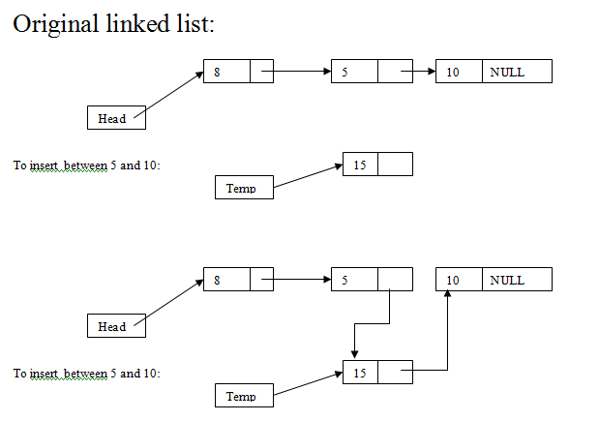
Example on inserting data somewhere in the middle of the list

Slide 57
Insertion at the end of the list
Algorithm/Procedure
  Get new data to be inserted
  Locate the last item in the linked list
  Search ‘null’ at the end of the list
  Create a new node
  Amend the pointer of the last by attaching it to the new created one
  Put ‘null’ at the end of the new node to indicate end of the list.
  See example on next slide

Slide 58

Example of insertion at end
Node 1
Node 2
Node 3 Null
New node 4 Null
Head
New insertion at the end

Slide 59
Deleting a specified node from list
Node can be deleted from linked list if not required any more.
Deleting first item/node
Deleting any item in middle
Deleting last item in the list

Slide 60
Deleting nodes in linked list
The following steps can be used to delete nodes from the list.
  locate the node that you want to delete
  Disconnect this node from the linked list by changing pointers.
  Return the node to the system

Slide 61
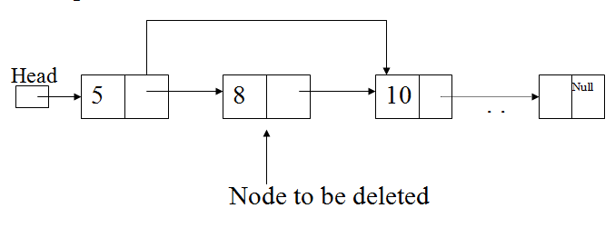
Example of node deletion from linked list

Slide 62
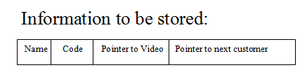
Application of Linked List
Main Items:
  Linked List of customers
  Linked List of video in Shop
Linked of Customers:

Slide 63
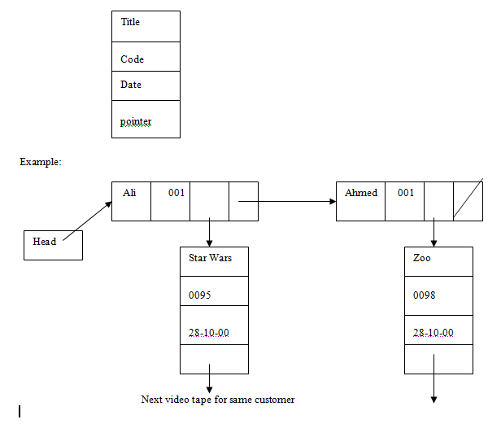
Example of video tape record

Slide 64
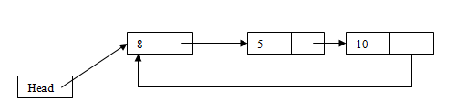
Variation of Linked List (1)
Circular linked list:
  No NULL value in the last node
  Last pointer pointing to the first item to make a linked list circular.

Slide 65
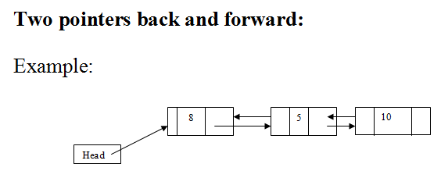
Variation of Linked List
Doubly Linked List:
  Where each has two pointer one is used for next/forward item and second one is used for previous/backward item.

Slide 66
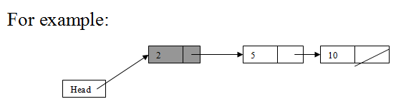
Variation of Linked List
Header Node:
  A special node in start if linked is used to keep important information about the whole linked list, for example, total number of nodes, average, highest score, etc.

Slide 67


